Slide 1

SPRING BATCH
The What and How of Batch Processing in Java
Notes:
ENIAC

Slide 2
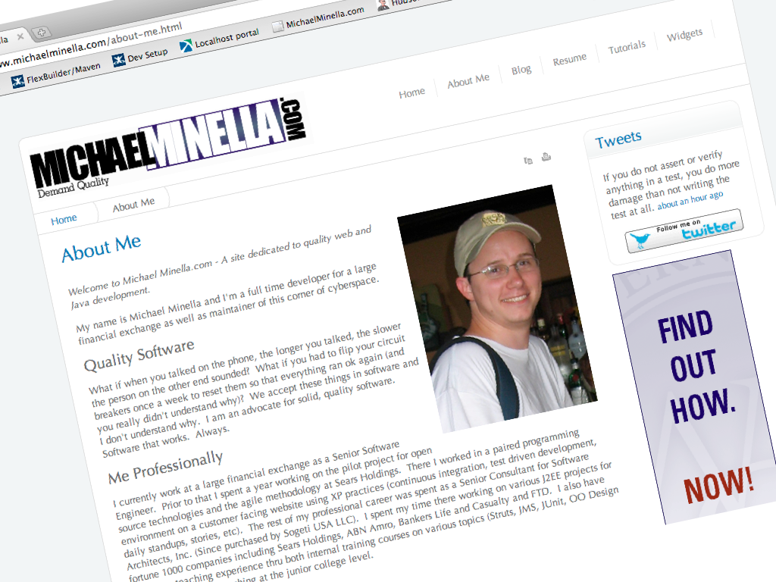

Slide 3

Notes:
http://www.flickr.com/photos/tanack/364573473/sizes/l/in/photostream/

Slide 4

What is batch processing?
Notes:
Definition
Challenges of batch processing

Slide 5
What is Spring Batch?

Slide 6
How does Spring Batch work?

Slide 7
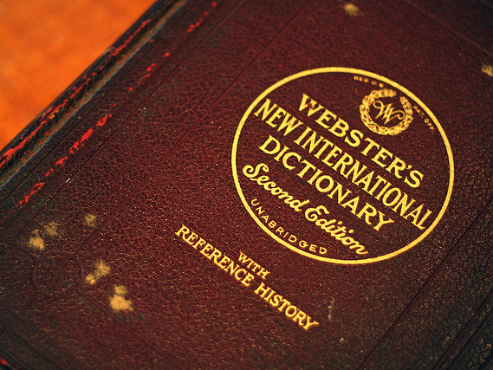
Notes:
http://www.flickr.com/photos/gadgetgirl70/2918038830/

Slide 8
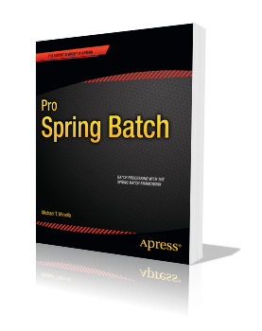
Batch processing, … is defined as the processing of data without interaction or interruption.

Slide 9


Slide 10

Notes:
http://www.flickr.com/photos/lastbeats/2550737319/
Twitter.com: 35 million a day
Amazon: 18 million a day
CNN: 7 million a day
Source of those numbers is google trends for websites: http://trends.google.com/websites?q=twitter.com%2C+cnn.com%2C+amazon.com&geo=all&date=all&sort=0

Slide 11
Challenges in batch processing
Maintainability
Scalability
Availability/Reliability
Security

Slide 12

Enter Spring Batch
Notes:
http://www.flickr.com/photos/jp1958/4204844775/sizes/l/in/photostream/

Slide 13
What is Spring Batch?

Slide 14


Notes:
Implement a standards based way to implement robust batch processes.

Slide 15
Features include:
Transaction management
Chunk based processing
Declarative I/O
Start/Restart/Skip capabilities
Scalability options including:
Multithreaded steps
Parallel steps
Remote chunking
Partitioning
Web administration interface
Notes:
Reusable components for the following
Chunk based processing
I/O – Declaritive
Start/Restart/Skip capabilities
Transaction management
Scalability options including
Multithreaded steps
Parallel steps
Partitioning
Remote Chunking
Web administration interface

Slide 16
Application
Core
Infrastructure
Notes:
Application tier = custom code/business logic.
Core tier = batch stuff (Job, Step, etc).
Infrastructure = I/O, transactions etc.

Slide 17
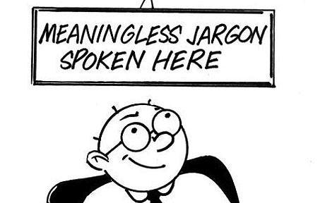

Slide 18
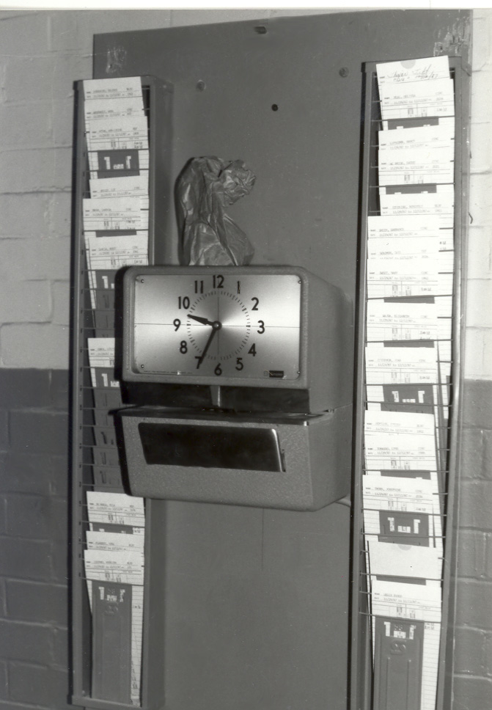
What is a Job?
Notes:
http://www.flickr.com/photos/ppl_ri_images/4019834273/
A Job is the definition of a process to be executed from start to finish without interruption.

Slide 19
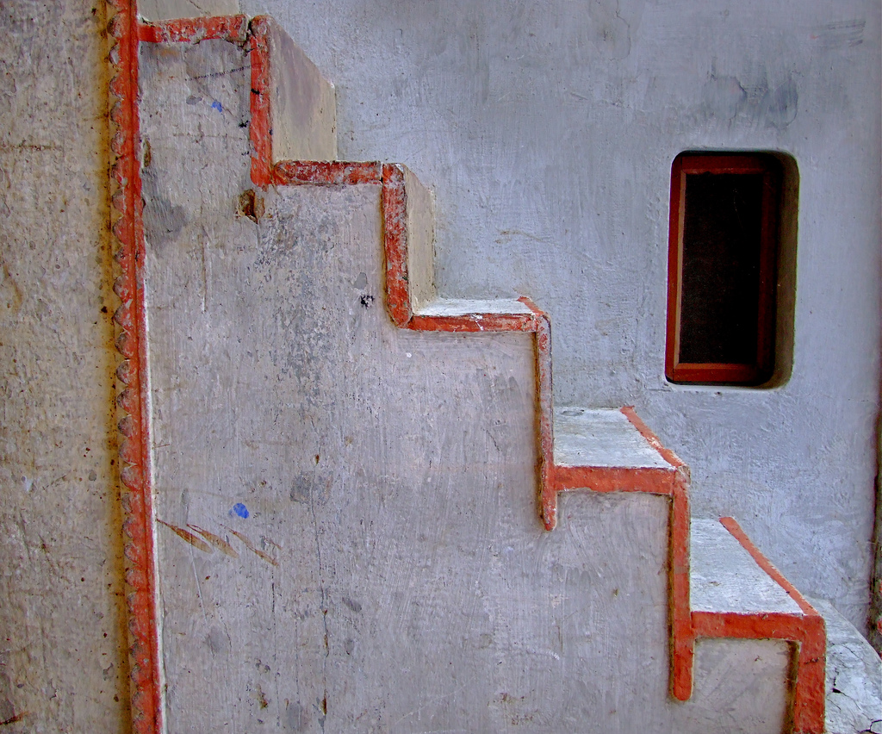
What is a Step?
Notes:
http://www.flickr.com/photos/judepics/2371279935/

Slide 20

What is an Item?

Slide 21
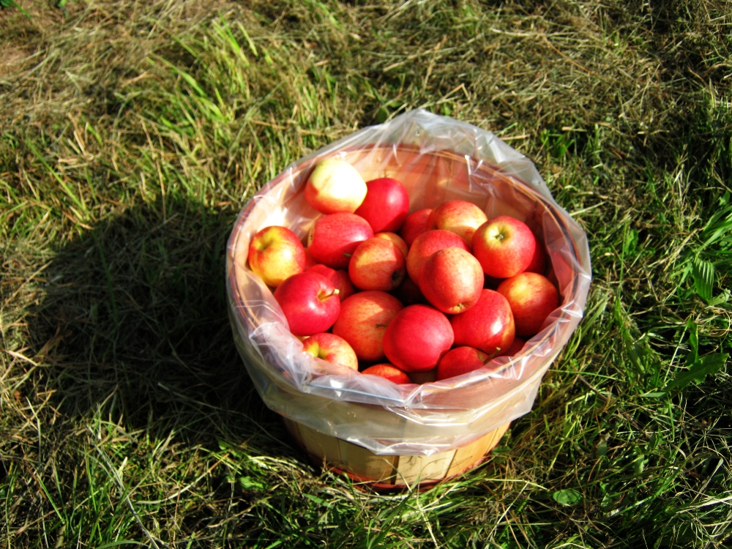
What is a Chunk?
Notes:
http://www.flickr.com/photos/allthingsmichigan/3947671573/

Slide 22
Job
Step1
Step2
Step3
ItemReader
ItemReader
ItemReader
ItemProcessor
ItemProcessor
ItemProcessor
ItemWriter
ItemWriter
ItemWriter

Slide 23
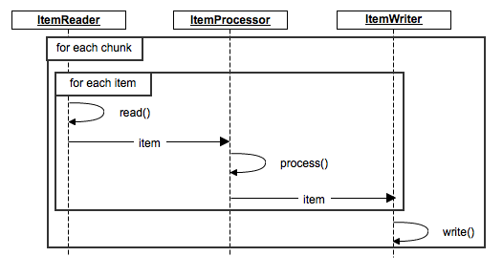

Slide 24
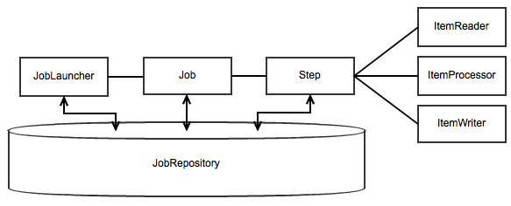

Slide 25
Declarative Item Reader/Writers Included:
Flat Files
XML
JDBC
JPA
Hibernate
Spring Services
JMS
Custom

Slide 26
MultiThreaded Step
Step1
Step2
Step3
Step2
Step2
ItemReader
ItemReader
ItemReader
ItemReader
ItemReader
ItemProcessor
ItemProcessor
ItemProcessor
ItemProcessor
ItemProcessor
ItemWriter
ItemWriter
ItemWriter
ItemWriter
ItemWriter

Slide 27
Parallel Steps
Step2a
ItemReader
ItemProcessor
Step1
Step3
ItemWriter
ItemReader
ItemReader
ItemProcessor
ItemProcessor
ItemWriter
Step2b
ItemWriter
ItemReader
ItemProcessor
ItemWriter

Slide 28
Remote Chunking
Step1
Step2
Step3
ItemReader
ItemReader
ItemReader
ItemProcessor
ItemProcessor
ItemWriter
ItemWriter
ItemWriter
Step2a
Step2a
Step2a
ItemReader
ItemReader
ItemReader
ItemProcessor
ItemProcessor
ItemProcessor
ItemWriter
ItemWriter
ItemWriter

Slide 29
Partitioning
Step1
Master
Step3
ItemReader
ItemReader
ItemProcessor
ItemProcessor
ItemWriter
ItemWriter
Slave1
Slave2
Slave3
ItemReader
ItemReader
ItemReader
ItemProcessor
ItemProcessor
ItemProcessor
ItemWriter
ItemWriter
ItemWriter

Slide 31
What Spring Batch is not
A scheduler
Lightweight….or heavyweight
A silver bullet

Slide 32
How does Spring Batch work?

Slide 33
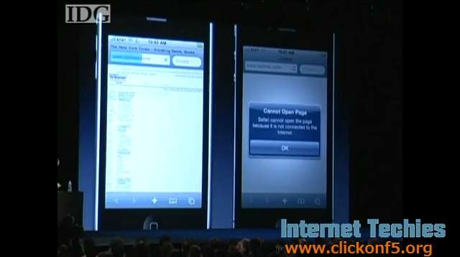
Pray to demo gods now…

Slide 34


Slide 35
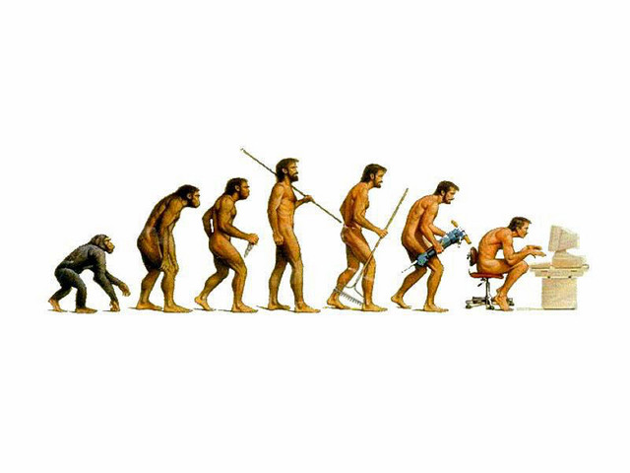
What’s next?

Slide 36
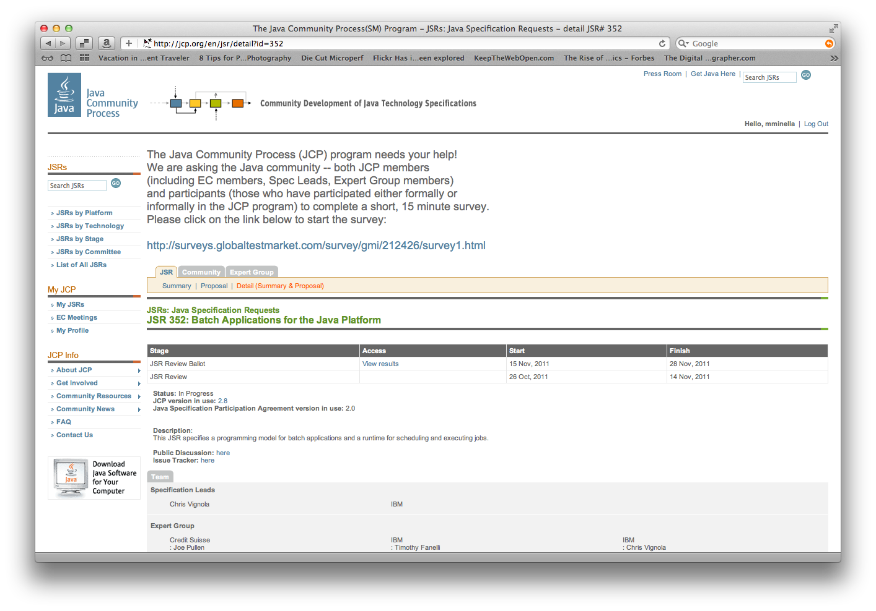
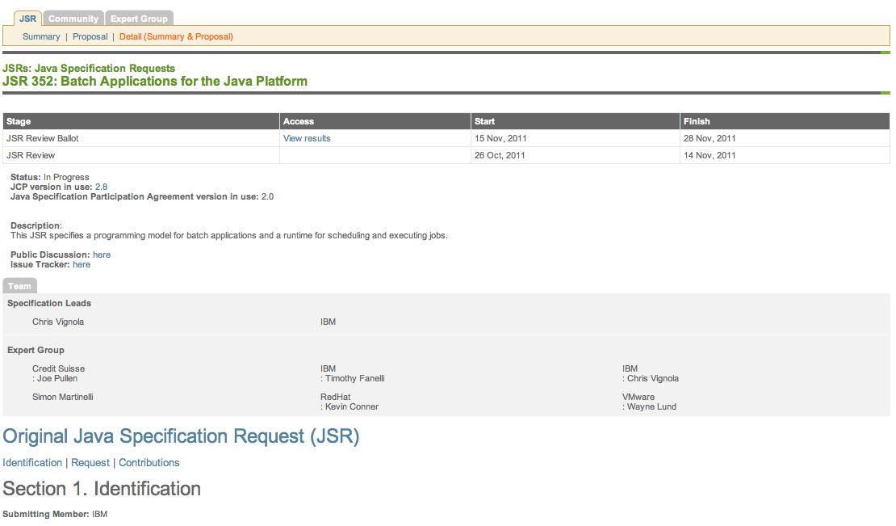

Slide 37
Images provided by:
Amy Barker
http://www.flickr.com/people/gadgetgirl70/
judepics
http://www.flickr.com/people/judepics/
jp1958
http://www.flickr.com/people/jp1958/
Koyota
http://www.flickr.com/people/tanack/
Carl A
http://www.flickr.com/people/lastbeats/

